Slide 1
Research Proposal

Slide 2
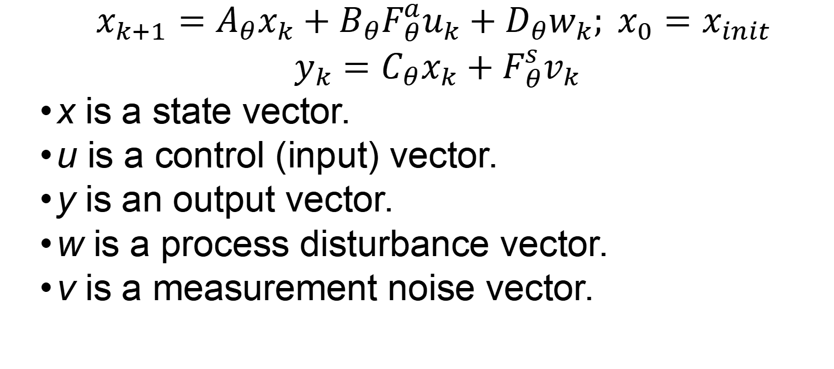
System Definition. Piecewise LTI.
$$x_{k+1}=A_{θ}x_{k}+B_{θ}F_{θ}^{a}u_{k}+D_{θ}w_{k}; x_{0}=x_{init}$$
$y_{k}=C_{θ}x_{k}+F_{θ}^{s}v_{k}$
x is a state vector.
u is a control (input) vector.
y is an output vector.
w is a process disturbance vector.
v is a measurement noise vector.
(1)

Slide 3
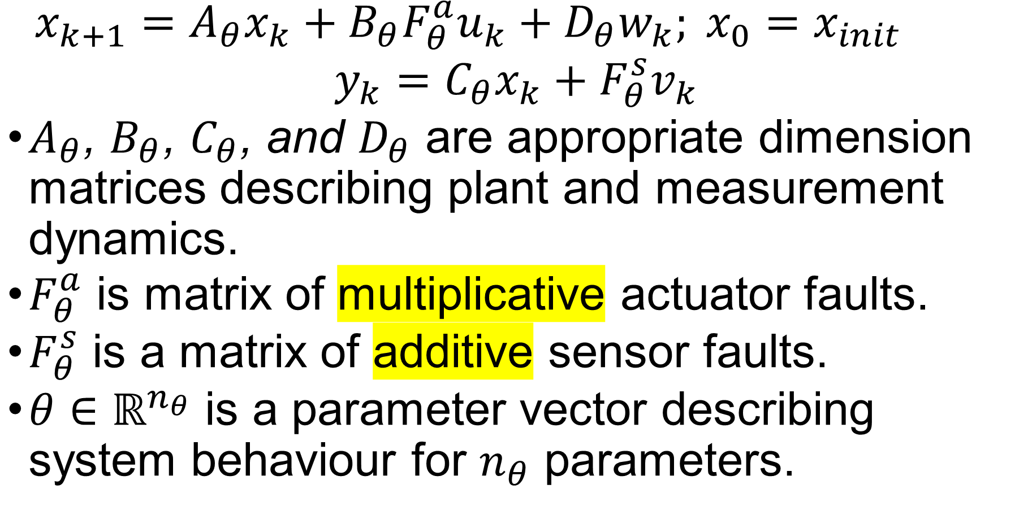
System Definition
$$x_{k+1}=A_{θ}x_{k}+B_{θ}F_{θ}^{a}u_{k}+D_{θ}w_{k}; x_{0}=x_{init}$$
$y_{k}=C_{θ}x_{k}+F_{θ}^{s}v_{k}$
$A_{θ}$, $B_{θ}$, $C_{θ}$, and $D_{θ}$ are appropriate dimension matrices describing plant and measurement dynamics.
$F_{θ}^{a}$ is matrix of multiplicative actuator faults.
$F_{θ}^{s}$ is a matrix of additive sensor faults.
$θ∈ℝ^{n_{θ}}$ is a parameter vector describing system behaviour for $n_{θ}$ parameters.
(1)

Slide 4
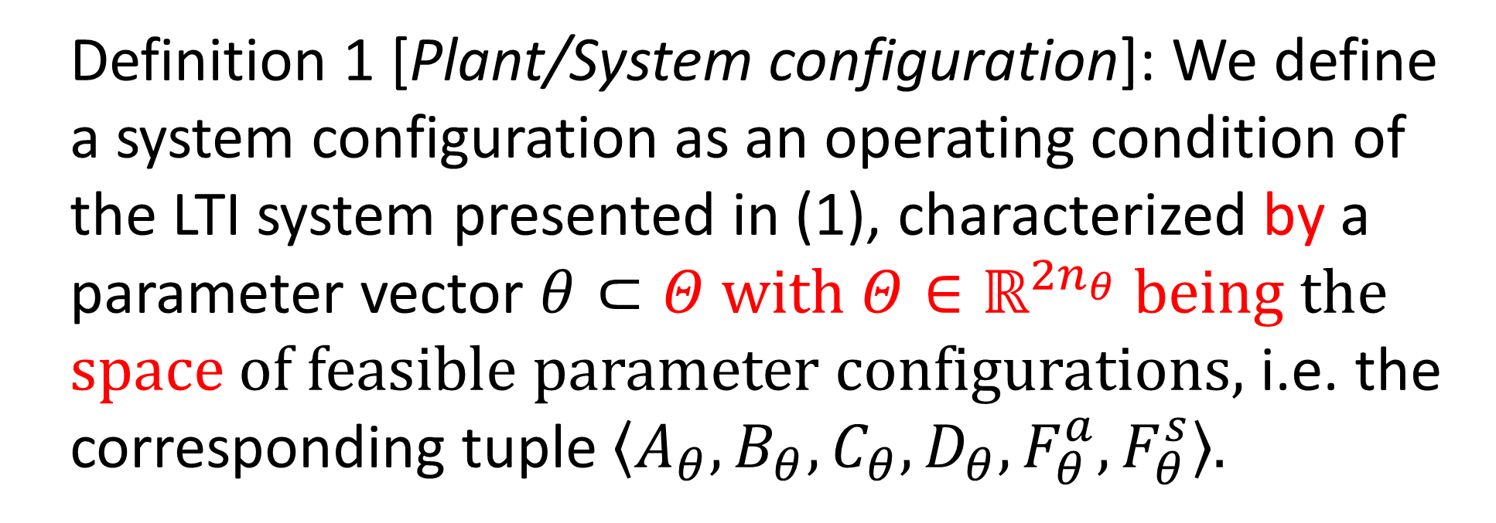
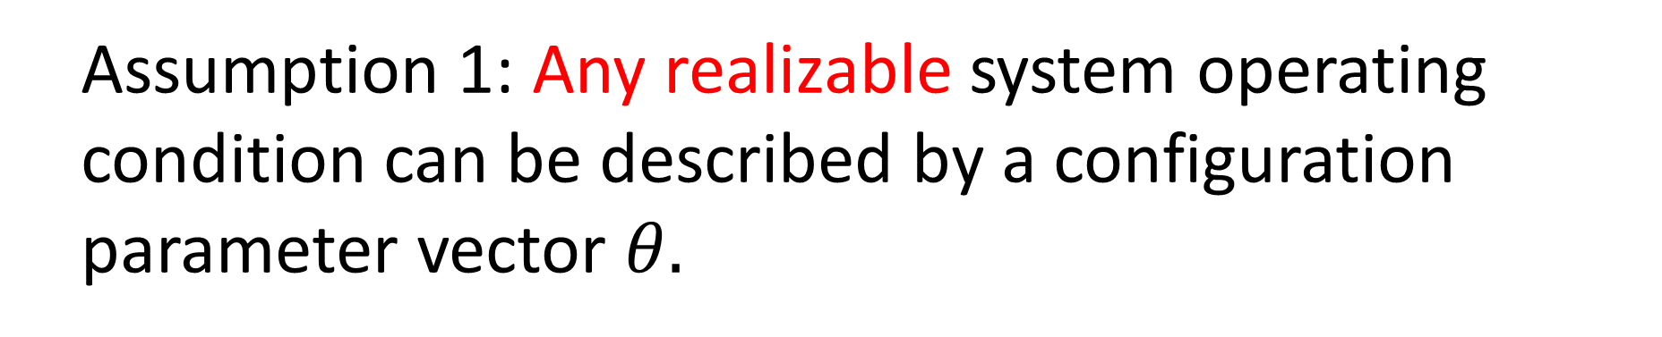
System Definition
Definition 1 [Plant/System configuration]: We define a system configuration as an operating condition of the LTI system presented in (1), characterized by a parameter vector $θ⊂Θ with Θ{∈ℝ}^{{2n}_{θ}}$ being the space of feasible parameter configurations, i.e. the corresponding tuple $〈A_{θ}, B_{θ}, C_{θ}, D_{θ}, F_{θ}^{a}, F_{θ}^{s}〉$.
Assumption 1: Any realizable system operating condition can be described by a configuration parameter vector $θ$.

Slide 5
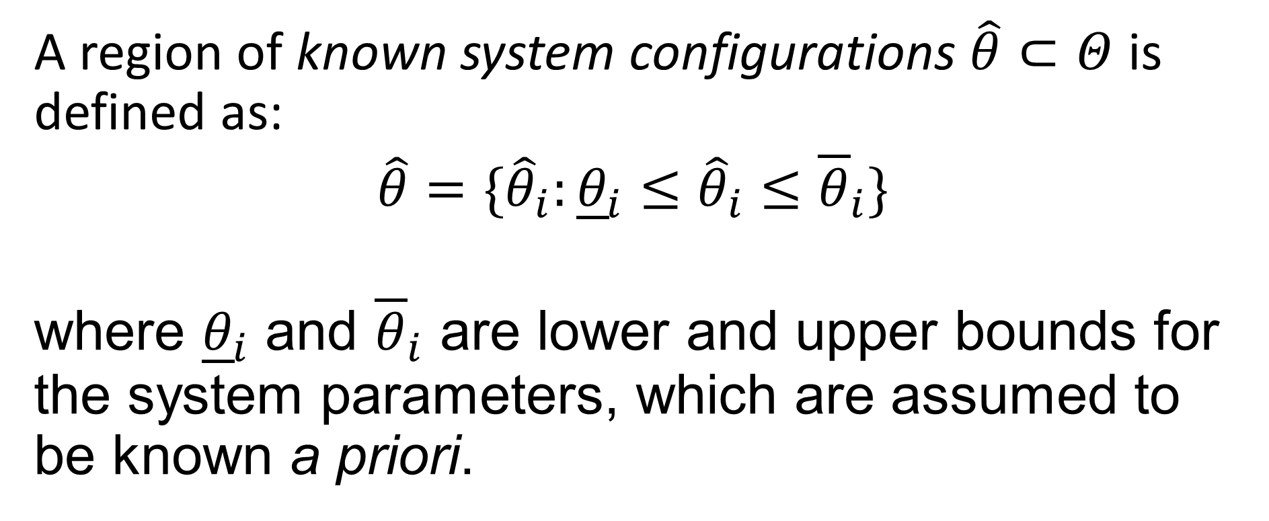
Known system configurations
A region of known system configurations $\hat{θ}⊂Θ$ is defined as:
$\hat{θ}=\{{\hat{θ}}_{i}:{\underline{θ}}_{i}≤{\hat{θ}}_{i}{≤\overline{θ}}_{i}\}$
where ${\underline{θ}}_{i}$ and ${\overline{θ}}_{i}$ are lower and upper bounds for the system parameters, which are assumed to be known a priori.

Slide 6
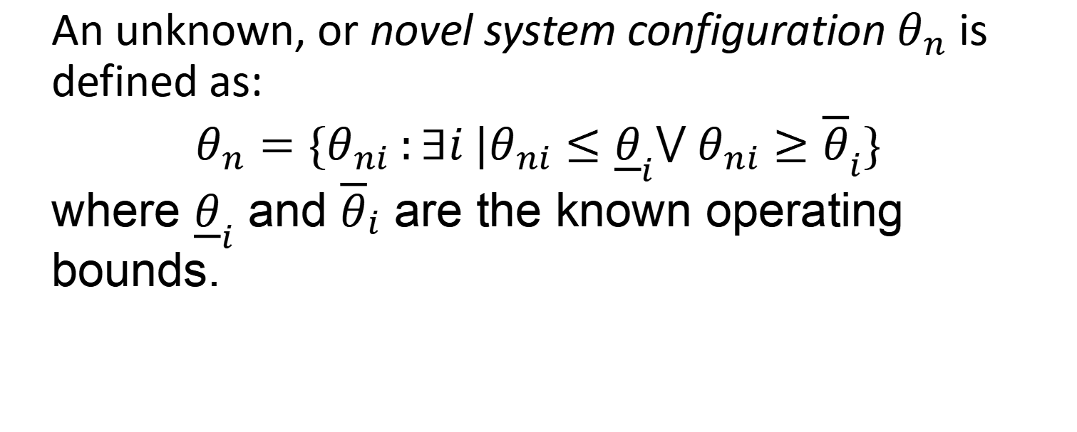


Unknown system configurations
An unknown, or novel system configuration $θ_{n}$ is defined as:
$θ_{n}=\{θ_{ni} :∃i |θ_{ni}≤{\underline{θ}}_{i}{⋁ θ_{ni}≥\overline{θ}}_{i}\}$
where ${\underline{θ}}_{i}$ and ${\overline{θ}}_{i}$ are the known operating bounds.
θ₂
Novel Configuration
$$\hat{θ}$$
Known
$$θ_{n}$$
θ₁

Slide 7
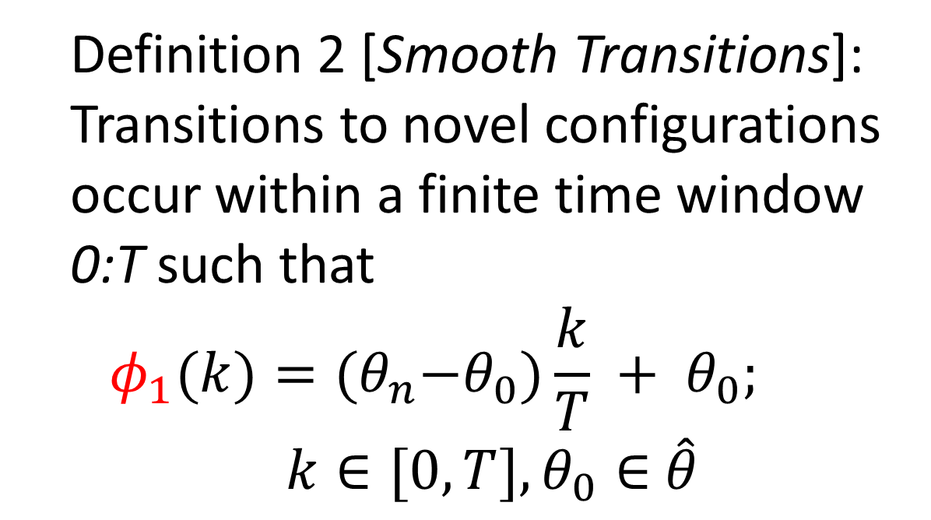


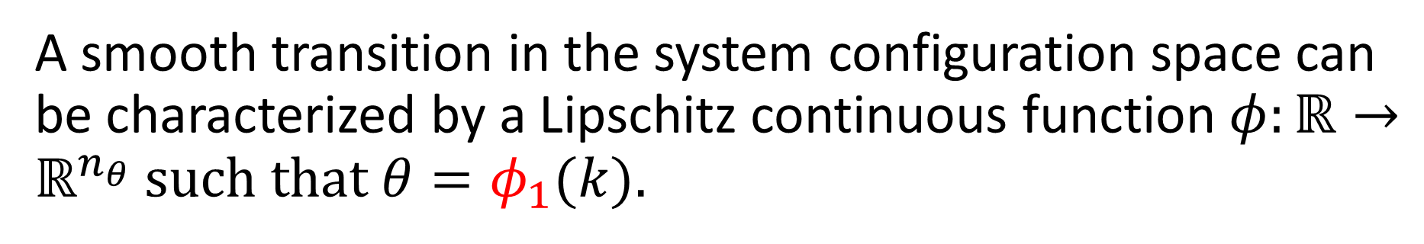
Smooth transitions to novel configurations.
A smooth transition in the system configuration space can be characterized by a Lipschitz continuous function $φ:ℝ→ℝ^{n_{θ}}$ such that $θ=φ_{1}(k)$.
Definition 2 [Smooth Transitions]: Transitions to novel configurations occur within a finite time window 0:T such that
$$φ_{1}(k)={(θ}_{n}−θ_{0})\frac{k}{T} + θ_{0};$$
$k∈[0,T], θ_{0}∈$ $\hat{θ}$
θ₂
$$\hat{θ}$$
$$θ_{n}$$
$$θ_{k=0}$$
θ₁

Slide 8
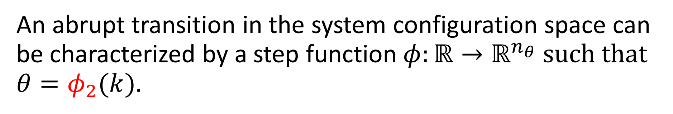

Abrupt transitions to novel configurations.
An abrupt transition in the system configuration space can be characterized by a step function $φ:ℝ→ℝ^{n_{θ}}$ such that $θ=φ_{2}(k)$.
Definition 3 [Abrupt Transitions]: Transitions to novel configurations occur at a given timestep $k_{T}$ such that:
$$φ_{2}(k)=\left\{\begin{aligned}θ_{0}, &k<k_{T} \\ θ_{n}, &k≥k_{T}\end{aligned}\right.;$$
$θ_{0}∈$ $\hat{θ}$
θ₂
$$\hat{θ}$$
$$θ_{n}$$
$$θ_{k=0}$$
θ₁

Slide 9
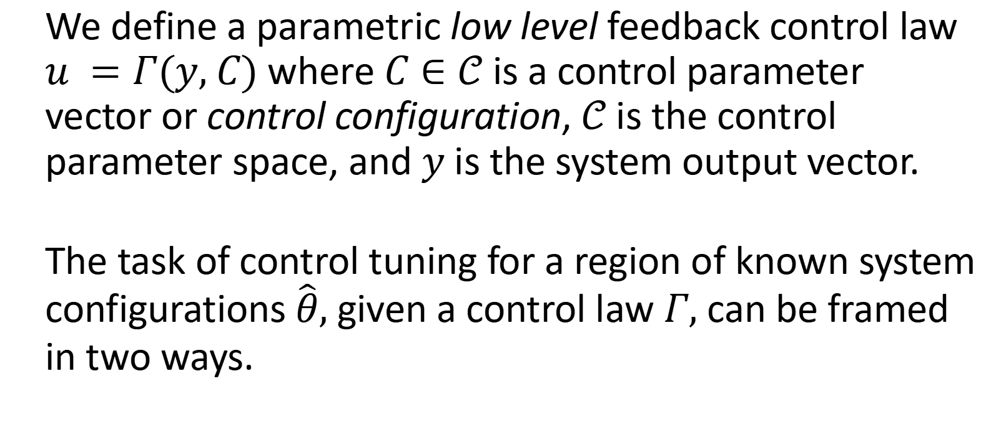
Low Level Control Law
We define a parametric low level feedback control law $u =Γ(y, C)$ where $C∈𝒞$ is a control parameter vector or control configuration, $𝒞$ is the control parameter space, and $y$ is the system output vector.
The task of control tuning for a region of known system configurations $\hat{θ}$, given a control law $Γ$, can be framed in two ways.

Slide 10
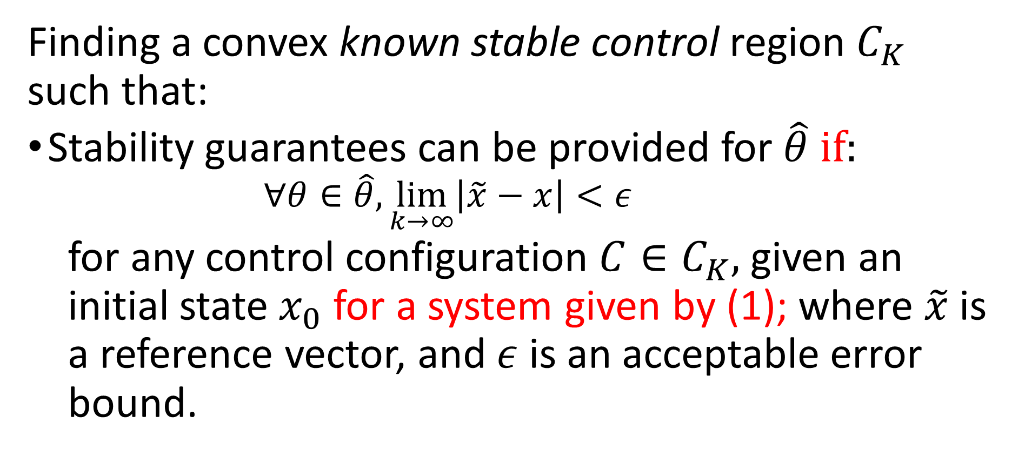
Stability-based control law tuning.
Finding a convex known stable control region $C_{K}$ such that:
Stability guarantees can be provided for $\hat{θ}$ if:
$$∀θ∈\hat{θ}, \lim_{k→∞}\left|\tilde{x}−x\right|<ε$$
for any control configuration ${C∈C}_{K}$, given an initial state $x_{0}$ for a system given by (1); where $\tilde{x}$ is a reference vector, and $ε$ is an acceptable error bound.

Slide 11
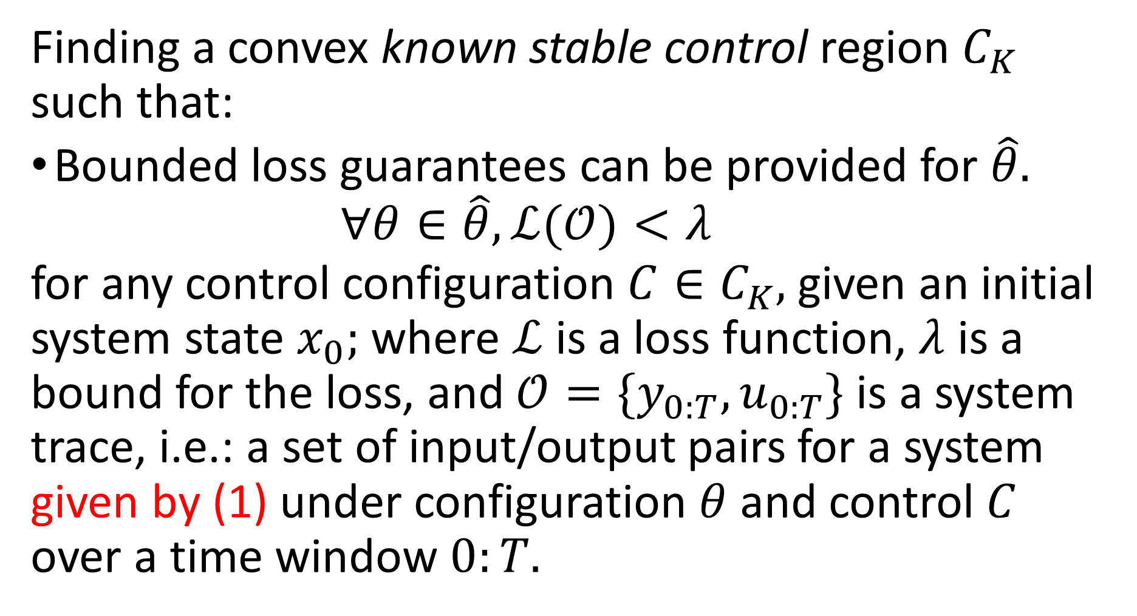
Loss-based control law tunning.
Finding a convex known stable control region $C_{K}$ such that:
Bounded loss guarantees can be provided for $\hat{θ}$.
$$∀θ∈\hat{θ}, ℒ(𝒪)<λ$$
for any control configuration ${C∈C}_{K}$, given an initial system state $x_{0};$ where $ℒ$ is a loss function, $λ$ is a bound for the loss, and $𝒪=\{y_{0:T},u_{0:T}\}$ is a system trace, i.e.: a set of input/output pairs for a system given by (1) under configuration $θ$ and control $C$ over a time window $0:T$.

Slide 12
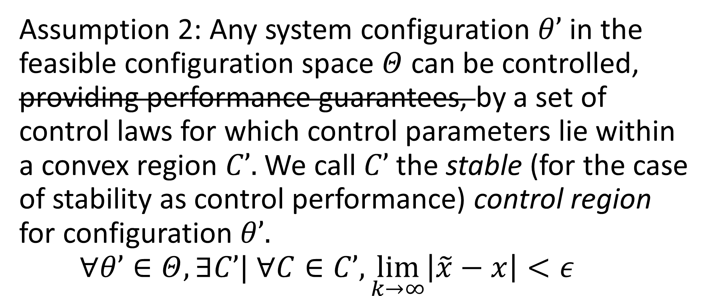
Stable Control Region.
Assumption 2: Any system configuration $θ’$ in the feasible configuration space $Θ$ can be controlled, providing performance guarantees, by a set of control laws for which control parameters lie within a convex region $C’$. We call $C’$ the stable (for the case of stability as control performance) control region for configuration $θ’$.
$$∀θ’∈Θ, ∃C’| ∀C∈C’, \lim_{k→∞}\left|\tilde{x}−x\right|<ε$$

Slide 13

Blended Control Law.
We define a blended control law $Ω$

Slide 14
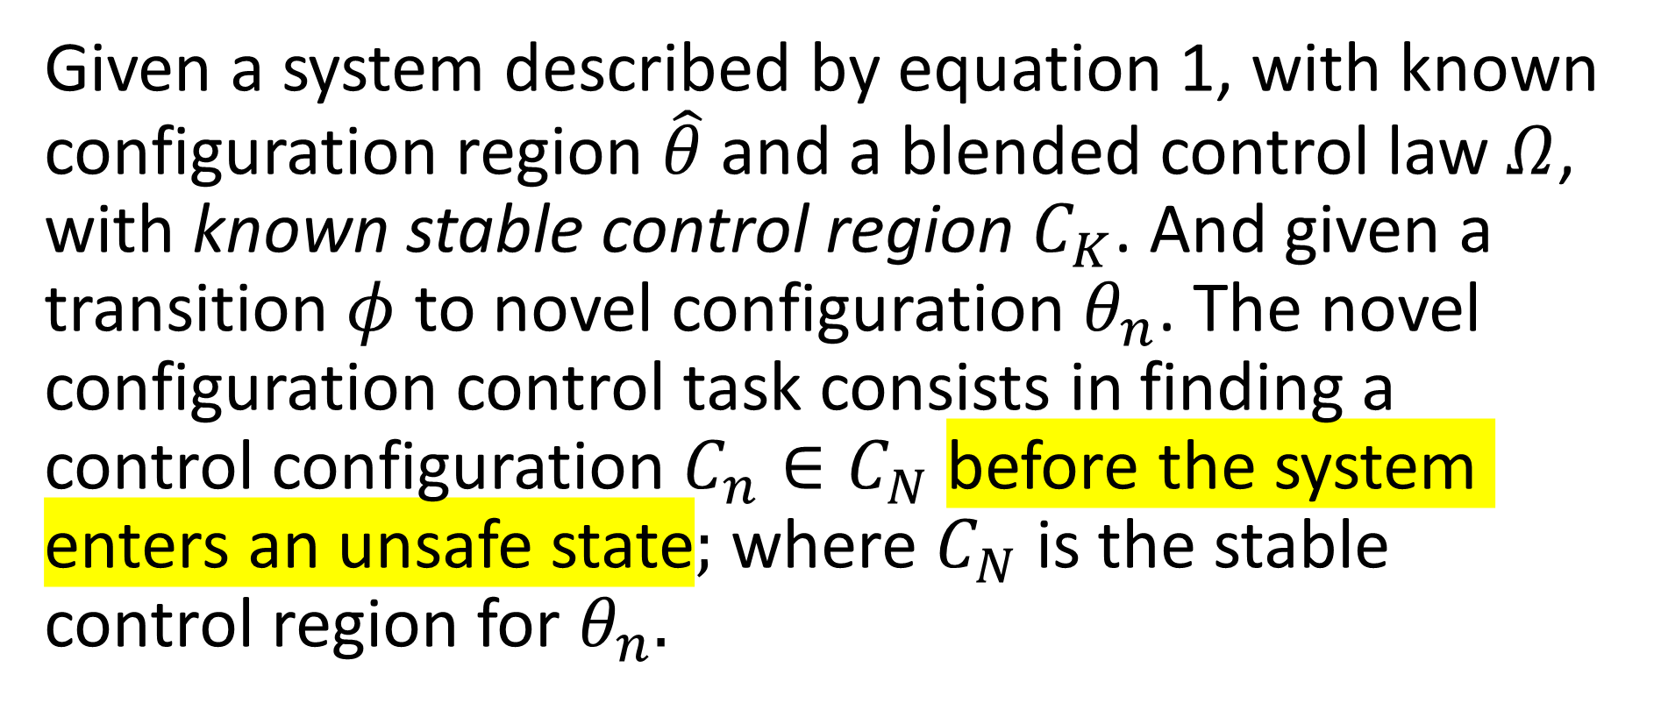
Problem Statement. Novel configuration control task.
Given a system described by equation 1, with known configuration region $\hat{θ}$ and a blended control law $Ω$, with known stable control region $C_{K}$. And given a transition $φ$ to novel configuration $θ_{n}$. The novel configuration control task consists in finding a control configuration $C_{n}∈C_{N}$ before the system enters an unsafe state; where $C_{N}$ is the stable control region for $θ_{n}$.

Slide 15
Problem Statement. Unsafe state.
Definition 4 [Unsafe State]:

Slide 16
Learning control for novel configuration
θ₂
C₂
Stable
Region for Novel Environment
Novel Configuration
C_{K}
Known
C_{N}
θ₁
C₁
θ₂
C₂
Learned
Control
C_{K}
Learned Control
Known
C_{n}ϵC_{N}
θ₁
C₁

Slide 17
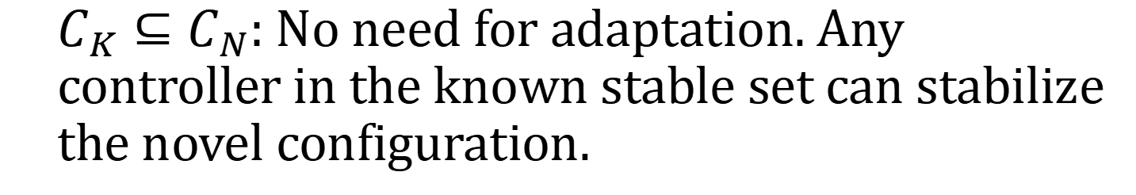
Possible stable regions:
C₂
C_{N}
C_{K}
C₁
$C_{K}⊆C_{N}$: No need for adaptation. Any controller in the known stable set can stabilize the novel configuration.

Slide 18
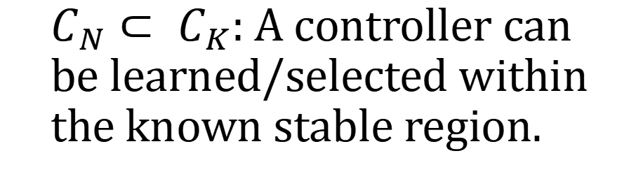
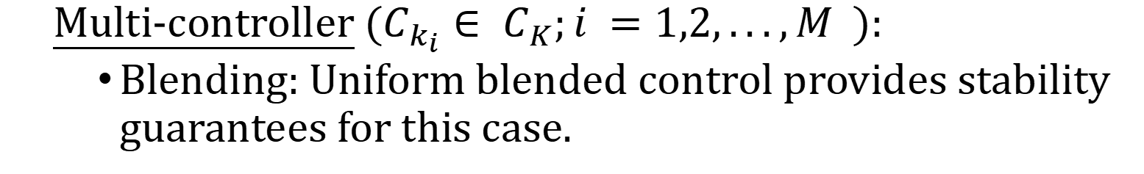
Possible stable regions:
C₂
$C_{N}⊂ C_{K}$: A controller can be learned/selected within the known stable region.
C_{N}
C_{K}
C₁
Multi-controller ($C_{k_{i}}∈ C_{K};i =1,2,...,M$ ):
Blending: Uniform blended control provides stability guarantees for this case.

Slide 19
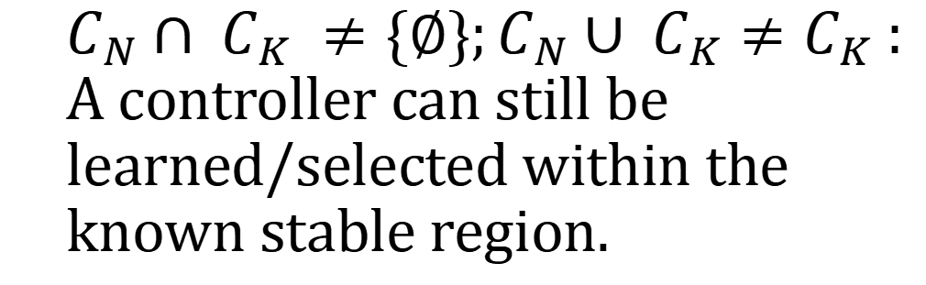
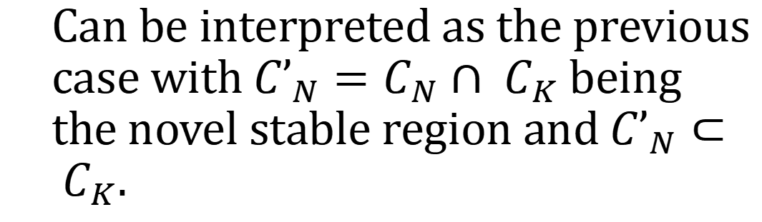
Possible stable regions:
C₂
$C_{N}∩ C_{K} ≠\{∅\};C_{N}∪ C_{K}≠C_{K}$: A controller can still be learned/selected within the known stable region.
C_{N}
C_{K}
C₁
C₂
Can be interpreted as the previous case with ${C’}_{N}=C_{N}∩ C_{K}$ being the novel stable region and ${C’}_{N}⊂ C_{K}$.
C’_{N}
C_{K}
C_{N}
C₁

Slide 20
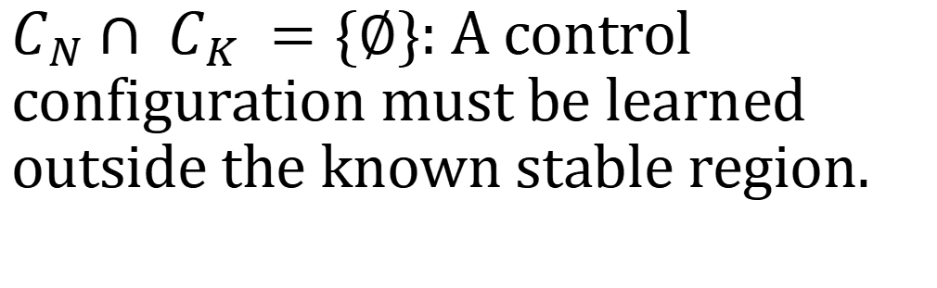
Possible stable regions:
C₂
$C_{N}∩ C_{K} =\{∅\}$: A control configuration must be learned outside the known stable region.
C_{N}
C_{K}
C₁
A completely new stable region must be learned.

Slide 21
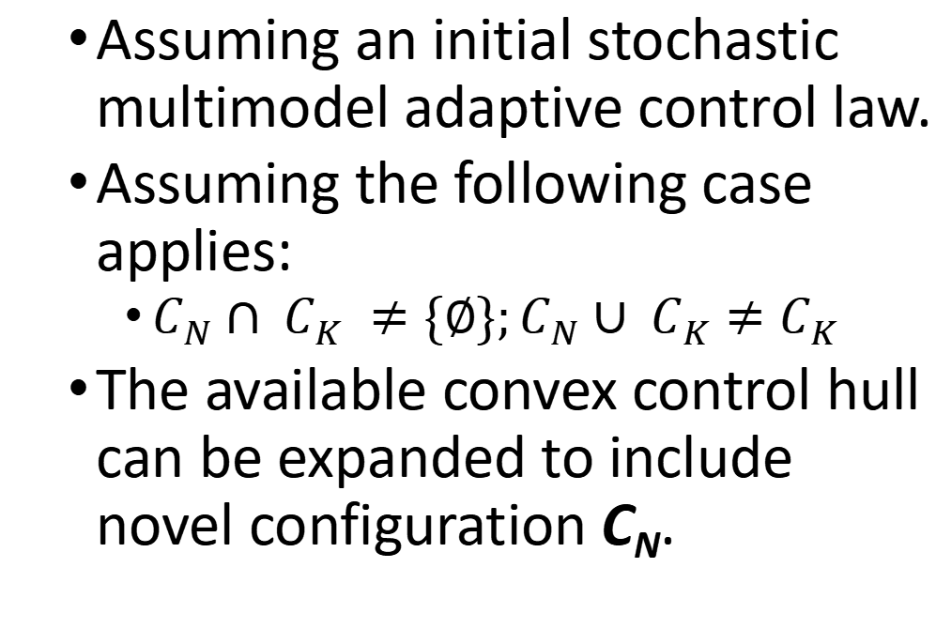
Control Parameter Space
Assuming an initial stochastic multimodel adaptive control law.
Assuming the following case applies:
$C_{N}∩ C_{K} ≠\{∅\};C_{N}∪ C_{K}≠C_{K}$
The available convex control hull can be expanded to include novel configuration C_{N}.
C_{N}
C₂
RBC
C_{n}
C₁
Task 2: Learn new mixing for new controller set.

Slide 22

Encoder
Decoder
Trace
$$\{y_{t−1},u_{t−1},y_{t}\}$$
Novel Control Synthesis
Control
Plant
Code
Control
Configuration

Slide 23
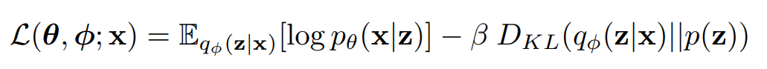
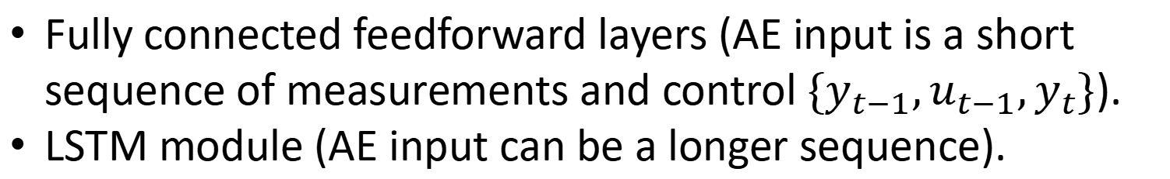
Autoencoder Architecture
Fully connected feedforward layers (AE input is a short sequence of measurements and control $\{y_{t−1},u_{t−1},y_{t}\}$).
LSTM module (AE input can be a longer sequence).
VAE Loss Function
Reconstruction error
Regularization for normalized latent space

Slide 24
Novel control synthesis
RL agent for online tuning of new controller.
State: VAE code (latent space).
Action:
Controller parameters.
Control regions:
Parameters for distribution over the control parameter space.
Control region bounds.

Slide 25
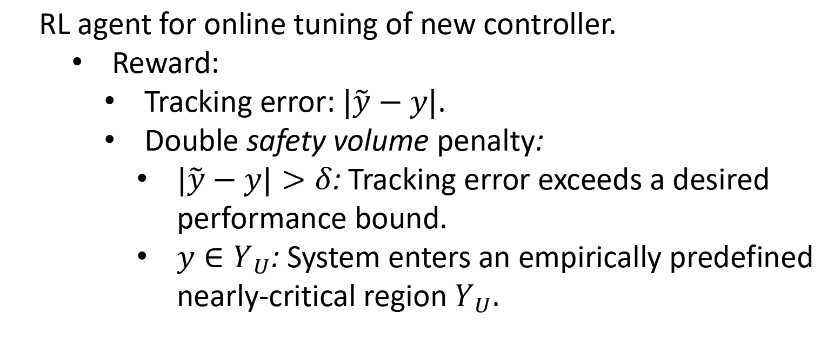

Novel control synthesis
RL agent for online tuning of new controller.
Reward:
Tracking error: $|\tilde{y}−y|$.
Double safety volume penalty:
$|\tilde{y}−y|>δ$: Tracking error exceeds a desired performance bound.
$y∈Y_{U}$: System enters an empirically predefined nearly-critical region $Y_{U}$.
Note: $\tilde{y}$ is a reference vector.
Note: The fact that $Y_{U}$ can change with novel dynamics is a potential problem.

Slide 26
Encoder
Decoder
Trace
$$\{y_{t−1},u_{t−1},y_{t}\}$$
Control
Plant
Code
Control
Configuration

Slide 27

Autoencoder Latent Space as Control Configuration
If the dimension of the control configuration space is too small, the reconstruction error might become too high.
Add a control loss term to the autoencoder loss function.
$$+ αℒ_{C}(z)$$
Reconstruction error
Regularization for normalized latent space
Control performance: (normalized) tracking error

Slide 28

How to reuse knowledge from the control mixing RL agent?
P
Assumption 3: Control configurations ‘closer’ to the novel controller will present a higher ‘performance’ when controling the novel environment.
RBC
Stable
Controller
for Novel Environment
D

Slide 29
How to reuse knowledge from the control selection RL agent?
By studying control configurations selected by the control mixing agent in previous timesteps, an estimate of the ‘direction’ of the novel controller can be used as knowledge for the novel control learning/searching algorithm.
P
RBC
Stable
Controller
for Novel Environment
D

